Slide 1


Circuit Card Inquiry Lab
Jessica Monize – RBT125

Slide 2

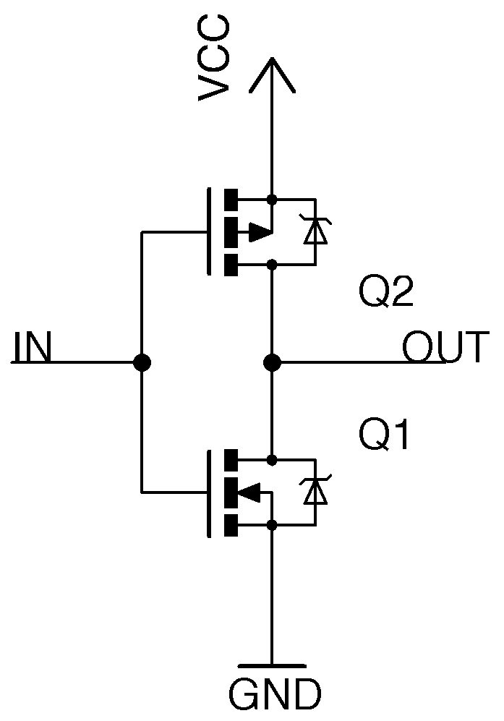


CMOS Inverter
CMOS which is also known as Complementary-Symmetry Metal–Oxide–Semiconductor
The CMOS is an inverted circuit used in small devices such as cell phones. The CMOS inverter is quick paced with minimal electronic waste. This device is used in small logic driven devices, among other things.

Slide 3


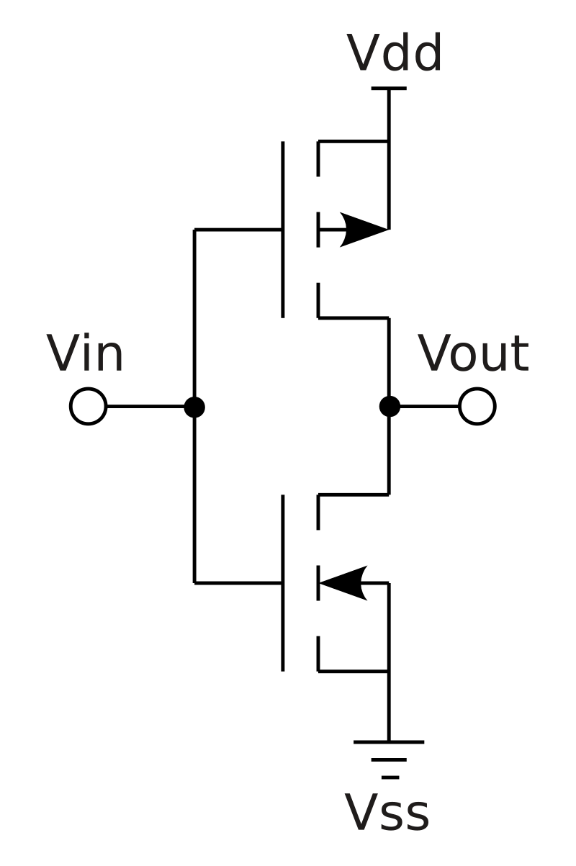

Where do we use it?
The CMOS is used mostly in small devices because of their quick speed and minimal loss of power. This device is used to produce data in small electronic circuits. Some of the different devices this inverter is found in are mobile phones, routers, network servers, modems and other small logic driven devices. Other places that the CMOS invert can be used is in transceivers, integrated circuits, memory chips, microprocessors, IC chips, static RAM, microcontrollers, RF circuits, data converters, image sensors and transceivers.

Slide 4

Advantages
Some of the advantages of using the Complementary-Symmetry Metal Oxide Semiconductor Inverter are: ○ The CMOS inverter’s power dissipation is very low, if noticeable at all. ○ The CMOS inverter uses power only when switched on and off resulting in minimal power usage. Which means less power waste and less extra heat.
○ The CMOS inverter blocks out high nose, helping keep the frequency in and out more stable and prevents unnecessary spikes. ○ The power it pulls is only grabbed in quick bursts before it switches back off which is what results in it having relatively low heat waste. ○ This inverter circuit is relatively cheap to create and produce in mass. ○ CMOS does not have any resistors which helps it keep the power usage in check.

Slide 5
Disadvantages
What are the disadvantages of the Complementary-Symmetry Metal Oxide Semiconductor Inverter? • The CMOS inverter’s switching speed is rather high. • This inverter is more difficult to fabricate. • Extra cost because of the steps it takes to create the CMOS inverter.
• It requires more space on the integrated circuit (IC) to use since it uses two transistors to create the inverter in comparison to the NMOS inverter.

Slide 6

Variations
What are the variations of this circuit? The ideal inverter in the CMOS is that if Vin= 0, Vout = Vdd. If Vin= Vdd, Vout = 0. When the input is low the output is high, when the input is high, the output is low. There may be other variations of the CMOS, but this is the ideal setup.

Slide 7
References
Sources
Pictures
Agarwal, T. (2022, January 27). CMOS inverter : Circuit, working, Characteristics & Its Applications. ElProCus. https://www.elprocus.com/cmos-inverter/
CMOS inverter characteristics - IDC-online. (n.d.). https://www.idc-online.com/technical_references/pdfs/electronic_engineering/Cmos_inverter_characteristics.pdf
Wikimedia Foundation. (n.d.). CMOS. Wikipedia. https://en.wikipedia.org/wiki/CMOS
NASA. (2019). Circuit | NASA. https://www.nasa.gov/
Praterma2. (n.d.). CMOS Inverter. praterma2.github.io/cards/src/cmos_inverter.html
Wikipedia. (n.d.). CMOS Inverter (a NOT logic gate). CMOS - Wikipedia

